Slide 1
Creating Thread
Rajasekaran S
Assistant Professor,
Department of Information Technology,
KGiSL Institute of Technology,
email: proffraja@gmail.com
Github:www.github.com/rajasekaranap

Slide 2
Creating Threads in Java
A class must extend form Thread.
Override run() method of Thread class.
Create an instance for user thread class .
Call the start method to invoke the thread.
LifeCycle Methods
void start()
void run()
void wait()
void stop()

Slide 3
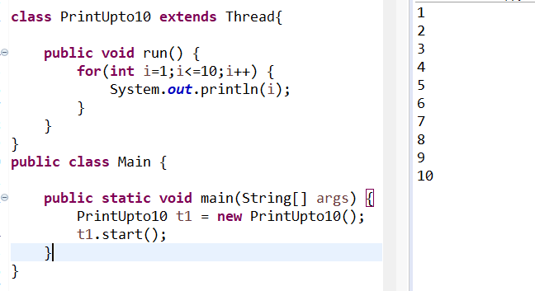
Simple Thread That Prints upto 10

Slide 4
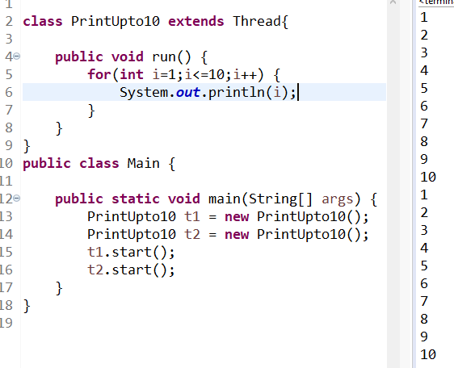
Invoking two threads

Slide 5
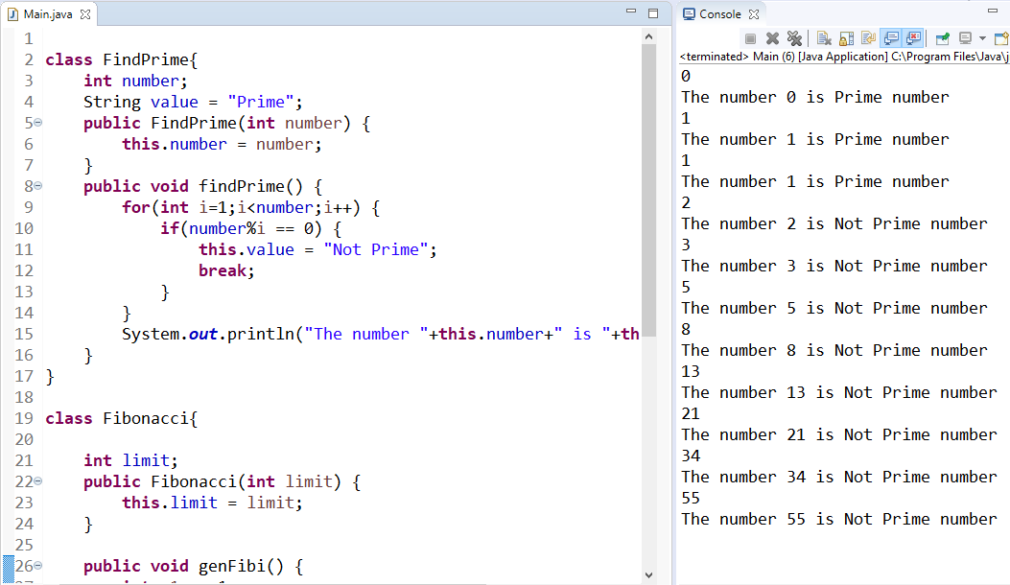
Fibonacci and Prime [Non Threading Approach]

Slide 6
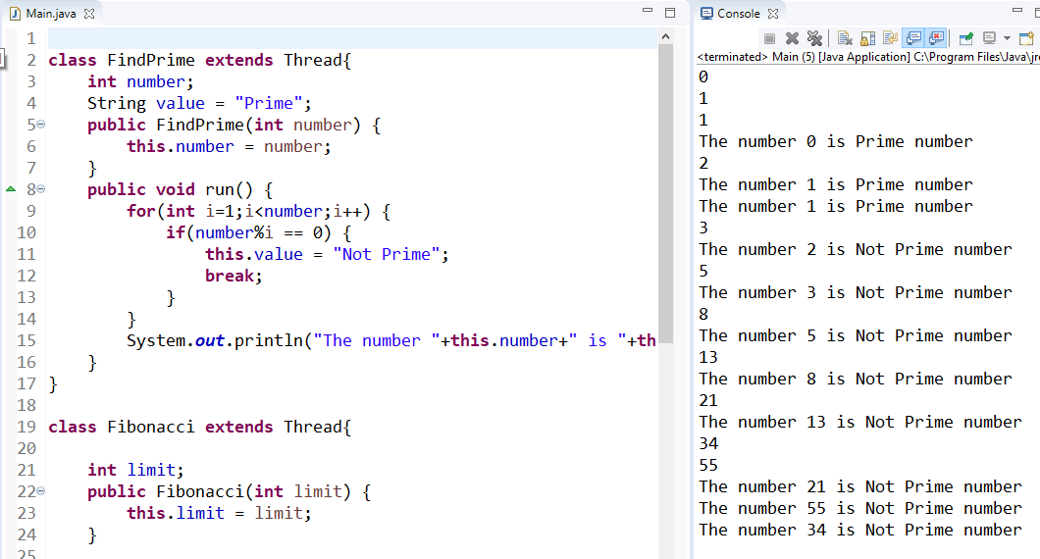
Fibonacci and Prime [Threading Approach]

Slide 7
Thank You
Rajasekaran S
Assistant Professor,
Department of Information Technology,
KGiSL Institute of Technology,
email: proffraja@gmail.com
Github:www.github.com/rajasekaranap

